Slide 1
NHS Benchmarking Tool
Team Project 3 - Team R

Slide 2
Motivation for the project
Project Overview
NHS Benchmarking tool is a online platform providing efficient and straightforward search functionality for estimation of a number of deprivation criteria.
Motivation
1
2
3

Slide 3
Key achievements
Straightforward design easy to be used by both professional analysts and other interested parties.
Thoroughly followed the NHS methodology for developing of a reliable estimation algorithm.
Collected all of the essential data for the most popular deprivation criteria
Carefully estimated the expectations where data was not available.
..

Slide 4
Product Features
Reliable data for most popular 11 deprivation criteria
Dynamic search functionality allowing filtering by criterion, age group, sex and locality
Available option for extending with subparameters for the deprivation criteria for which further data is available.
Search for multiple parameters
Results table with total estimate, estimate, low and upper range
.csv export feature
Completed all features requested during the user acceptance testing

Slide 5
Technical Features
Wrote a script to collect the data for the deprivation criteria.
Completely tested front end.
Back-end developed using a dependency injection system for simplified maintenance.
Fully tested back-end using both unit and integration test techniques with a test application context.
Implemented estimation algorithm producing estimations for deprivation criteria.
A DB migration script for easy migrating of the DB and its data to another DB server
Instructions for automatic DB updates
Front ends style conforming to Crichton Observatory and NHS style standards

Slide 6
Product Challenges
Communication with the client - (requires time to schedule a meeting or get an email reply, client is a profession busy with its own responsibilities - quite often the case)
Collecting data
Changes of requirements

Slide 7
Technical Challenges
Setting up the back end
Testing the back end
Setting up Jenkins
Connecting back end to deployed DB due to university network restrictions

Slide 8
Technical Decisions and Rationale
Back-end - Spring MVC used for back end. Why:
Some of the teammates were familiar with it
Appropriate for an enterprise application. Easy for maintenance by IT professionals and for extension. Highly structured with defined system architecture.
Back-end Testing Strategy. Combination of unit, Spring MVC, and integration tests. Why:
Unit tests to test isolated components.
Spring MVC tests to test handling of URL HTTP Restful Requests. Allows setting up of a test application context, mock functionality, and testing client sending requests the web services server.
Front-end - AngularJS. Why:
Team familiar with technology appropriate for dynamic, single page applications with a sophisticated search logic.

Slide 9
Live Demonstration

Slide 10

Main page

Slide 11
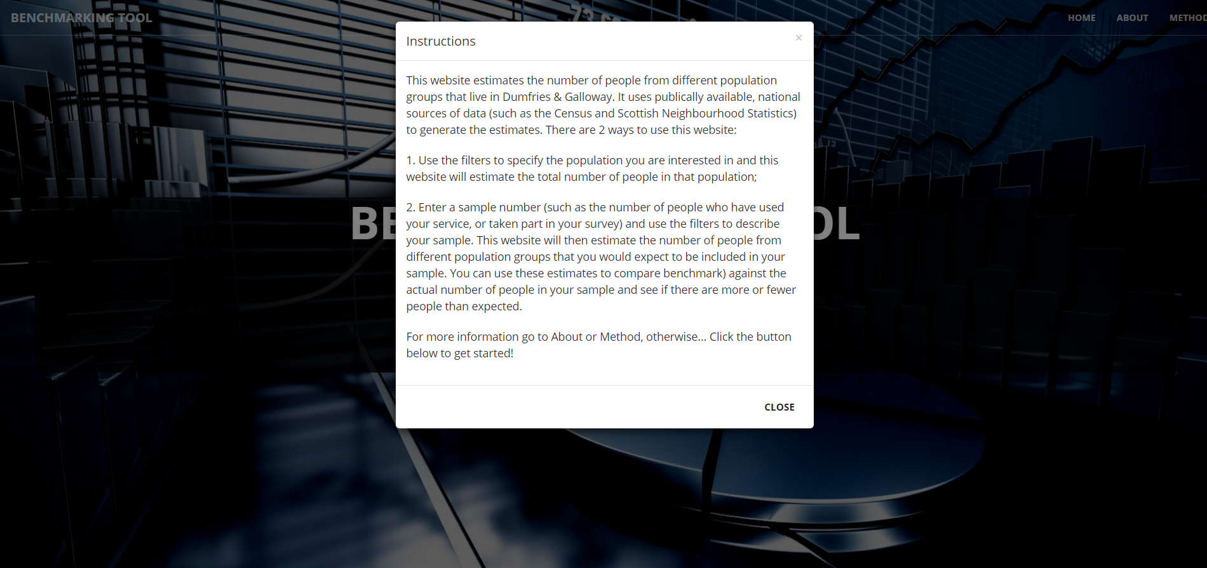
Instructions

Slide 12
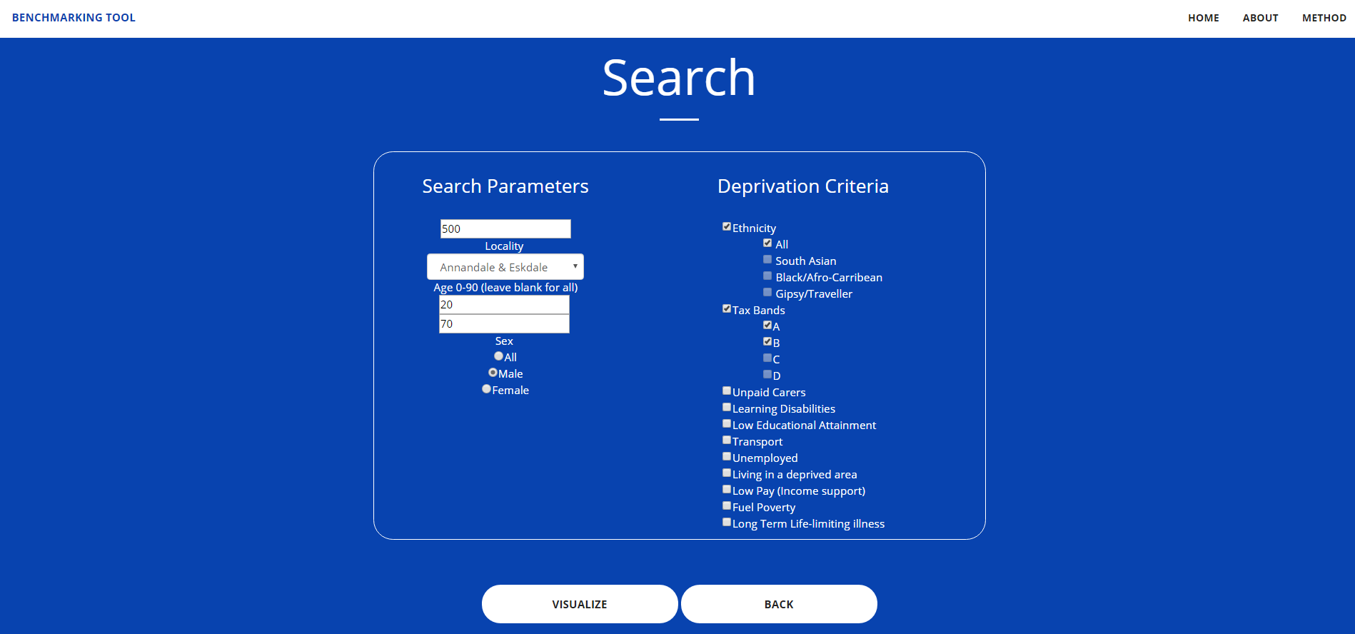
Search View

Slide 13
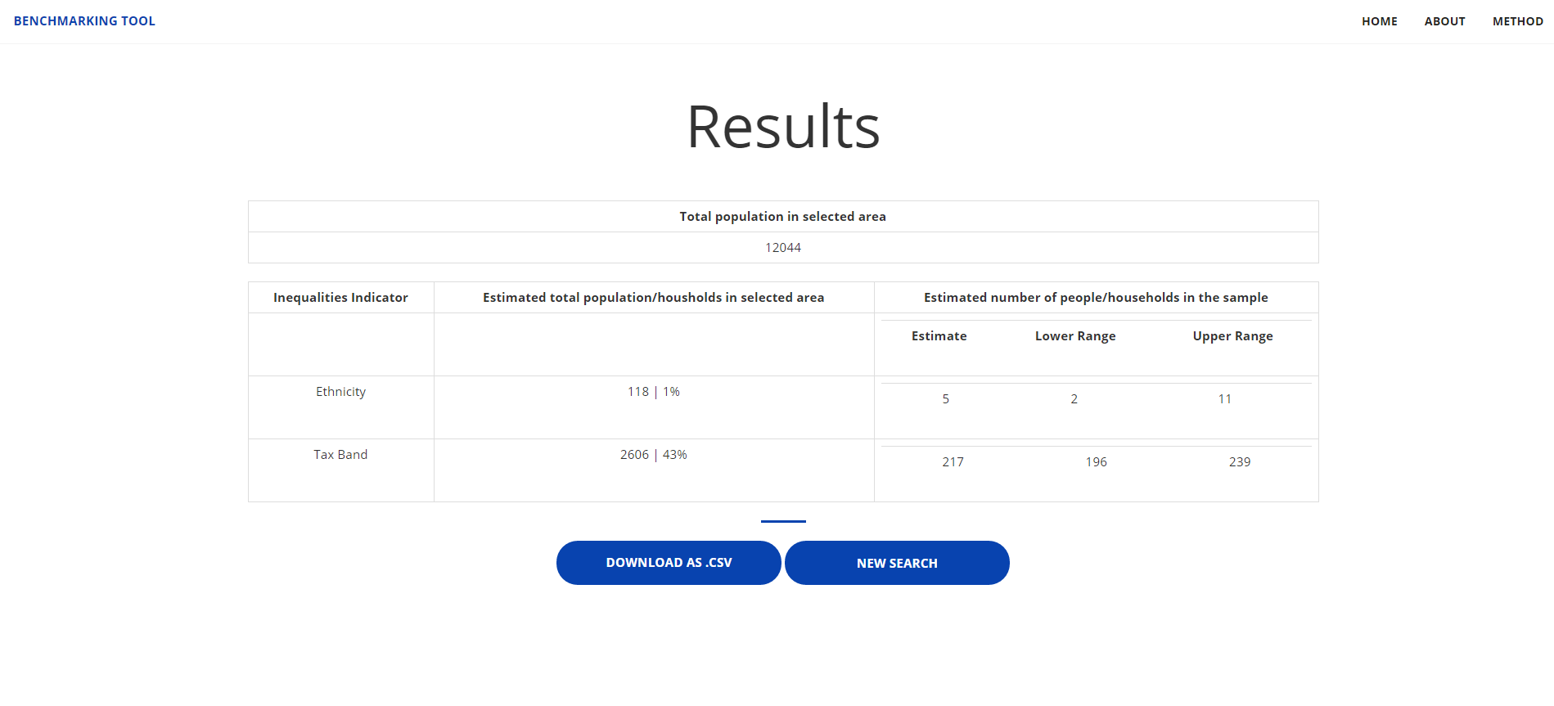
Results View

Slide 14

About Page

Slide 15
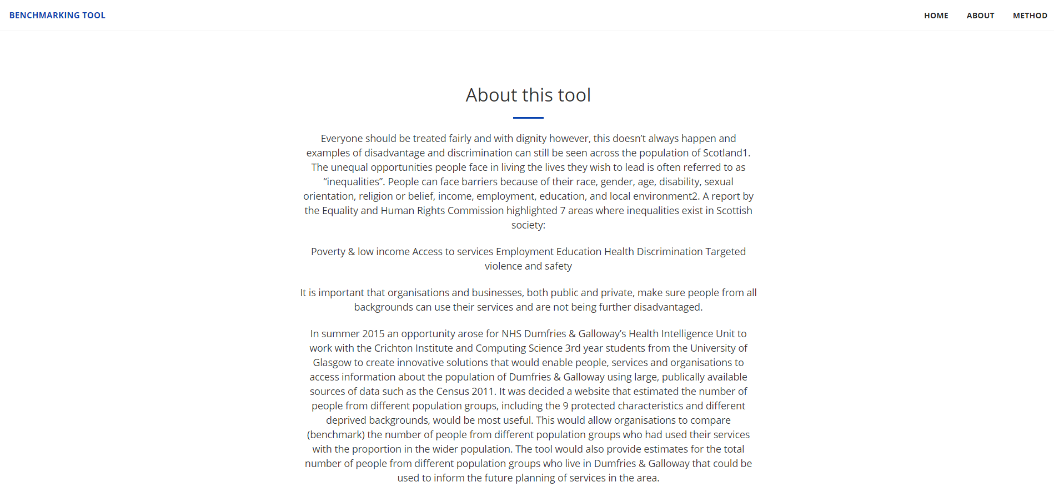
About Page

Slide 16

Method Page

Slide 17
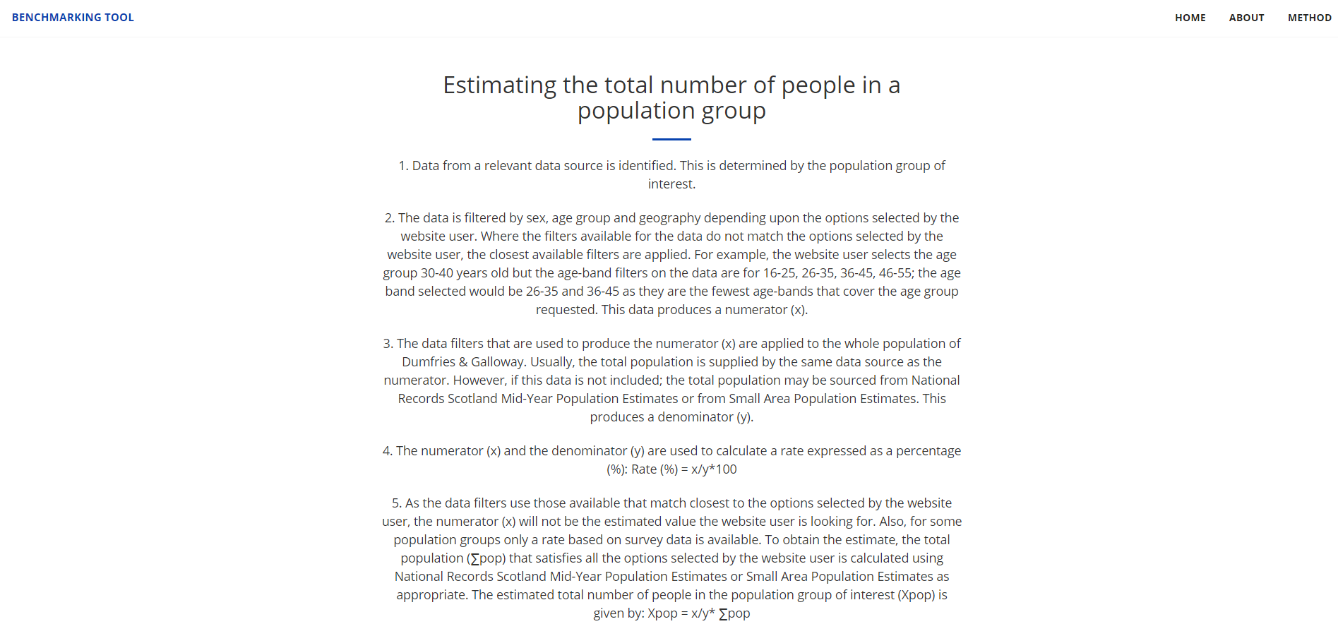
Method Page

Slide 18
Proposals for future work
Provide an excel / pdf export
More deprivation criteria
Add a subparameters filtering
Administration panel for easy access the DB and uploading of new data
Automatic retrieval and storing of new available deprivation criteria data through an API /script functionality

Slide 19
Any Questions?

